Slide 1


BANK LOAN CASE STUDY

Slide 2

CONTEXT
CONTEXT
PROJECT DESCRIPTION
APPROACH
TECH-STACK USED
Insights
OVERALL APPROACH OF ANALYSIS
DATA CLEANING
OUTLIERS
DATA IMBALANCE
UNIVARIATE ANALYSIS
SEGMENTED UNIVARIATE ANALYSIS
BIVARIATE ANALYSIS
CORRELATIONs
VISUALIZATIONS
RESULT

Slide 3

PROJECT DESCRIPTION
This case study is designed to help us to understand how to apply EDA (Exploratory Data Analysis) in a real business setting. Using the techniques we've learned in the EDA module gives you a basic understanding of risk analytics in banking and financial services. We'll also learn how data is used to minimize the risk of losing money when lending to customers. Our goal is to provide you with a practical example of how EDA can be used in a real-world scenario.

Slide 4


APPROACH
We will be performing our analysis on Microsoft Excel using various in-built formulas of Excel and we will go step by step in finding out the answers to the questions asked related to the data set. For this, first, we will understand the various columns, the data it contains, and their characteristics then we will start with validating our data. Also, I am gonna perform the EDA process to create various visualizations.

Slide 5

TECH STACK USED
MICROSOFT EXCEL
TABLEAU
POWERPOINT
It enables users to format, organize and calculate data in a spreadsheet
It helps to create the visualizations and charts
To create the plan, structure related to the business to make business strategies

Slide 6

INSIGHTS

Slide 7

OVERALL APPROACH OF ANALYSIS
PROBLEM STATEMENT
APPROACH
The loan-providing companies face challenges in approving loans for individuals with insufficient or non-existent credit history. This can lead to some customers taking advantage of the situation by defaulting on their loans. This can lead to financial loss for the bank.
It’s important for these companies to accurately assess an applicant’s likelihood of repaying the loan to avoid financial losses. By using exploratory data analysis(EDA), patterns in the data can be analyzed to identify applicants who are capable of repaying the loan. This will help ensure that deserving applicants are not rejected and the company can make informed decisions to minimize financial risks

Slide 8

DATA CLEANING
I have utilized the COUNTBLANK function to determine the number of blank cells in each row of a particular column.
Additionally, I have identified and removed a few columns that were deemed irrelevant to the analysis.
This approach helps to streamline the data and focus on the relevant information, making it easier to draw meaningful insights from the data.
COUNTBLANK FUNCTION
The COUNTBLANK function is used to count the number of empty cells in a given range of cells.
In financial analysis, the function can be useful in highlighting or counting empty cells in a given range
Example of COUNTBLANK function is
=COUNTBLANK(A2:AK2)

Slide 9

OUTLIERS
Outliers in Excel are the data points ​or sets of values that are significantly different from the average or expected range in a statistical sample or division. These outlying values may be unnecessary anomalies for your data analysis or spreadsheet needs.

Slide 10

OUTLIERS
I used a box and whisker chart to identify any unusual data points, or outliers, in our dataset.
Specifically, I focused on the annuity and down payment columns to find any extreme values.
Annuity refers to a series of equal payments made over time, while a down payment is an initial payment made when purchasing something.
I created two sets of data, one before data cleaning and one after data cleaning, to compare and see how the outliers affected the overall dataset, resulting in a noticeable difference between the two sets.
Before data cleaning
After data cleaning

Slide 11
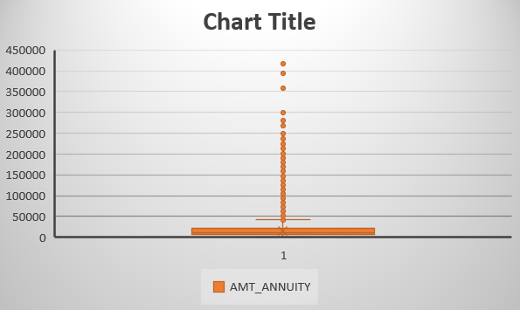
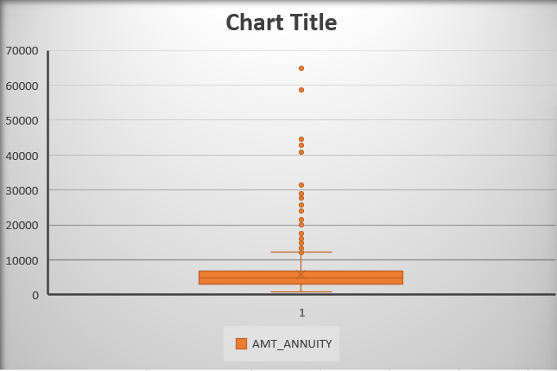
ANNUITY OUTLIER
Here is the annuity before and after data cleaning.
You can see the difference between them
ANNUITY
Before data cleaning
ANNUITY
After data cleaning

Slide 12
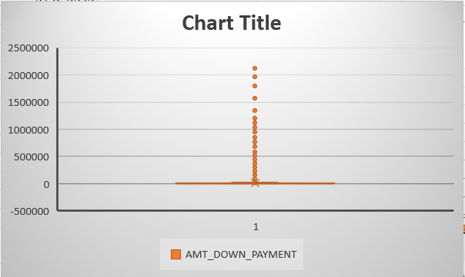
DOWN PAYMENT OUTLIER
Here is the down payment before and after data cleaning.
You can see the difference between them
DOWN PAYMENT
Before data cleaning
DOWN PAYMENT
After data cleaning

Slide 13

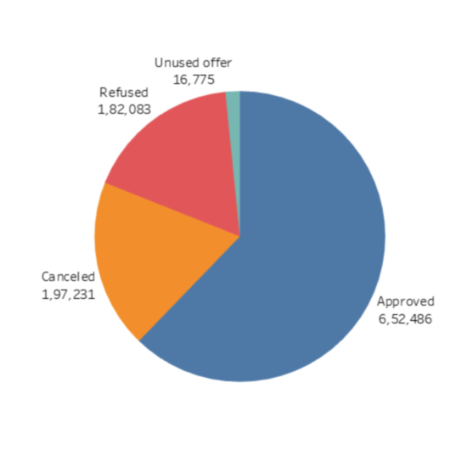
DATA IMBALANCE
Data imbalance means uneven distribution of observations in the data set.
I have taken the status of previous loan applications to know the data imbalance and calculate the ratio of data imbalance.
To calculate the ratio of data imbalance, we need to find out the range between the largest and smallest values, then based on the range we need to find out the ratio for each value.
The ratio for the status of approval applications is 62.23%
The ratio for the status of canceled applications is 18.82%
The ratio for the status of the refused application is 17.36%
The ratio for the status of unused offer applications is 1.60%

Slide 14
DIFFERENT TYPES OF ANALYSIS

Slide 15

UNIVARIATE ANALYSIS
Univariate analysis is a basic method of analyzing data that focuses on a single variable.
The term "uni" refers to "one", indicating that the data being analyzed has only one variable, unlike regression analysis, the univariate analysis does not explore relationships or causes between variables.
Instead, its primary objective is to describe the data by summarizing it and identifying patterns within it.
By examining a single variable, univariate analysis can provide insights into the distribution, central tendency, and variability of the data, which can be useful in identifying trends and patterns.

Slide 16
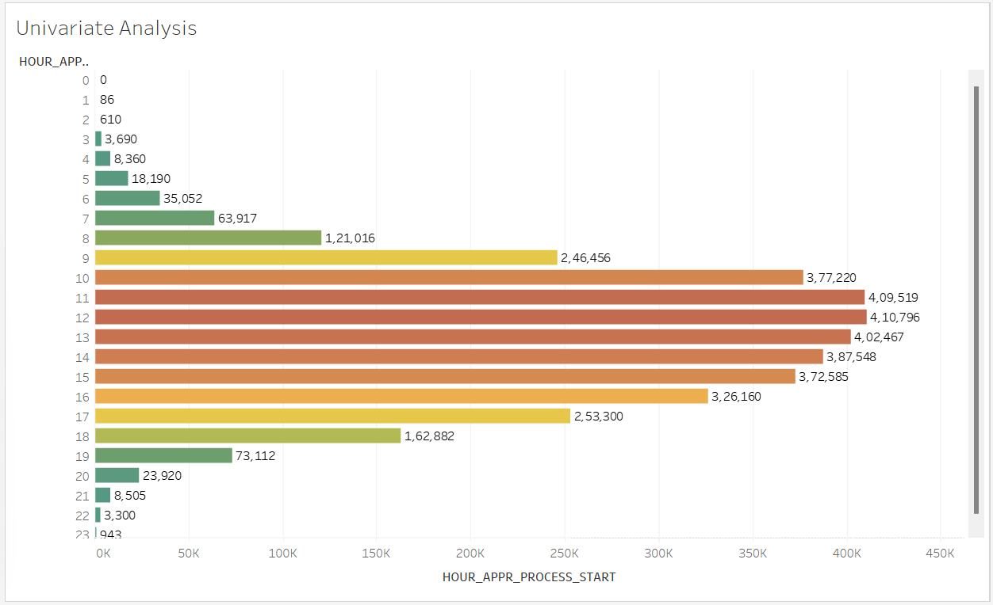
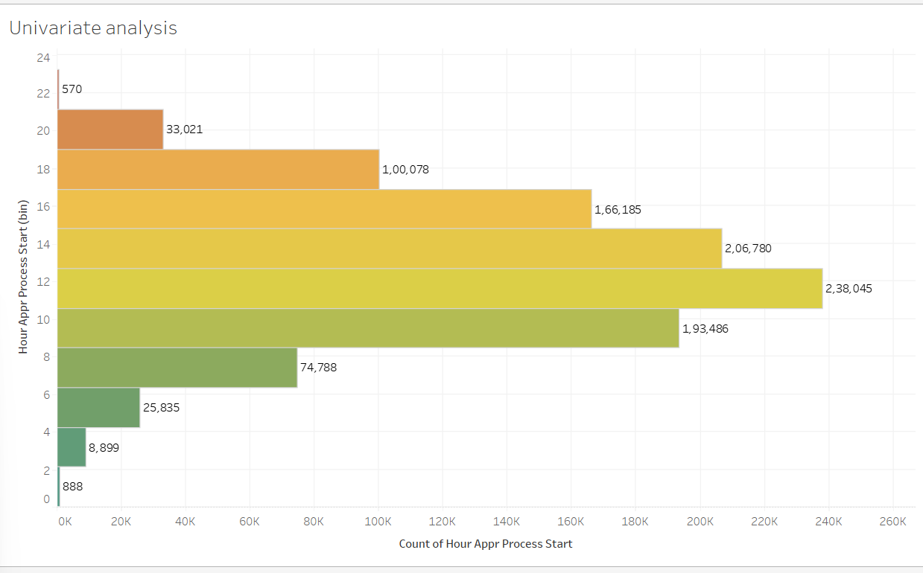
UNIVARIATE ANALYSIS…2
Current application
We are going to determine the peak arrival time of clients using the HOUR_APPR_PROCESS_START column.
To do this, we need to compare the arrival times throughout the day.
It is 12 PM in the current application and 11 AM in the previous application.
Previous application

Slide 17
SEGMENTED UNIVARIATE ANALYSIS
Segmented Univariate Analysis is one of the simplest forms of visualization to analyze data.
The segmented analysis here means that the data variable is analyzed in subsets and is very useful as it can show the change metric in pattern across the different segments of the same variable.
It can be used to find a summary of a single data variable in the form of segments.
The dataset variable is divided into subsets and patterns can be observed across the segments.
The central tendencies such as mean, mode, and median; maximum and minimum; range; variance and standard deviation are also detected.

Slide 18
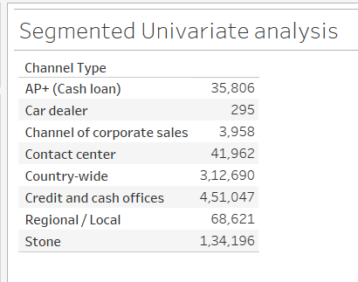
SEGMENTED UNIVARIATE ANALYSIS…2
The segmented analysis here means that the data variable is analyzed in subsets and is very useful as it can show the change metric in pattern across the different segments of the same variable.
It can be used to find a summary of a single data variable in the form of segments.
The central tendencies such as mean, mode, and median; maximum and minimum; range; variance and standard deviation are also detected.
I have taken the channel-type column for this analysis

Slide 19
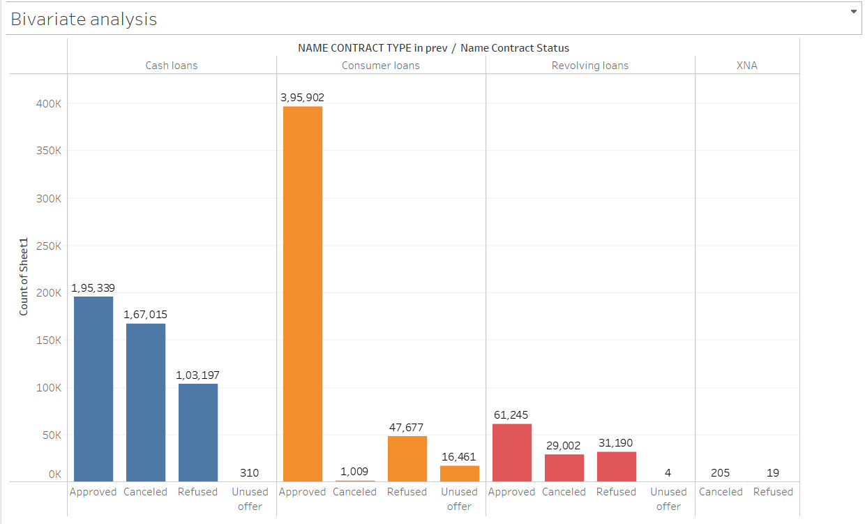
BIVARIATE ANALYSIS
Bivariate analysis is used to find the relationship between two sets of data. It usually involves two variables.
By examining the two variables, bivariate analysis can provide insights into the distribution, central tendency, and variability of the data, which can be useful in identifying trends and patterns.
I have taken contract type and contract status columns in previous application data.

Slide 20

CORRELATIONS
Correlation is a statistical method used to assess a possible linear association between two continuous variables.
To calculate the correlation, we need to select a blank cell at any place and write the formula.
Eg: =CORREL(A2:A7, B2:B7)

Slide 21
TOP 10 CORRELATIONS
I have used the CORREL function to find out the correlations between columns.
Here are the top 10 correlations from the application sheet.
S.No | Column-1 | Column-2 | Correlation
1 | YEARS_BUILD_MEDI | YEARS_BUILD_AVG | 0.998495
2 | OBS_60_CNT_SOCIAL_CIRCLE | OBS_30_CNT_SOCIAL_CIRCLE | 0.99849
3 | FLOORSMIN_AVG | FLOORSMIN_MEDI | 0.997241
4 | FLOORSMAX_MEDI | FLOORSMAX_AVG | 0.997034
5 | ENTRANCES_MEDI | ENTRANCES_AVG | 0.996886
6 | COMMONAREA_AVG | COMMONAREA_MEDI | 0.995978
7 | BASEMENTAREA_AVG | BASEMENTAREA_MEDI | 0.994317
8 | LIVINGAPARTMENTS_AVG | LIVINGAPARTMENTS_MEDI | 0.993825
9 | NONLIVINGAPARTMENTS_AVG | NONLIVINGAPARTMENTS_MEDI | 0.990768
10 | NONLIVINGAPARTMENTS_MEDI | NONLIVINGAPARTMENTS_MODE | 0.978575

Slide 22
VISUALIZATIONS

Slide 23
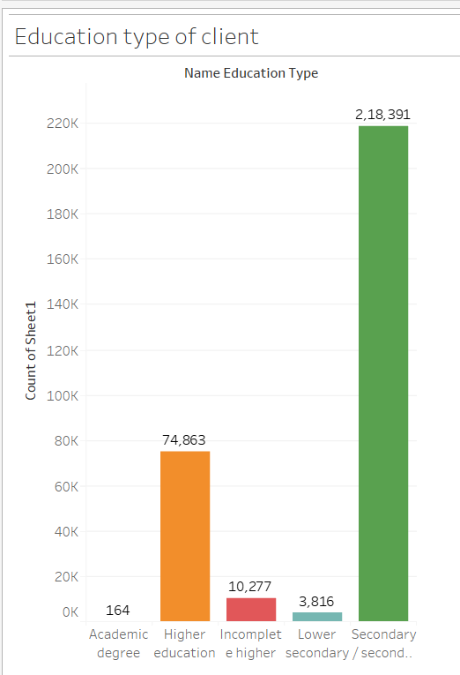
EDUCATION TYPE OF CLIENTS
Clients with a higher level of education may have a better understanding of budgeting, saving, and managing debt, which could make them less likely to experience payment difficulties.
On the other hand, clients with a lower level of education may be less familiar with financial concepts and may be more likely to struggle with managing their finances, which could lead to payment difficulties.
By understanding the education type of clients, we can tailor our approach to providing financial education and support to help them improve their financial literacy and avoid payment difficulties in the future.

Slide 24
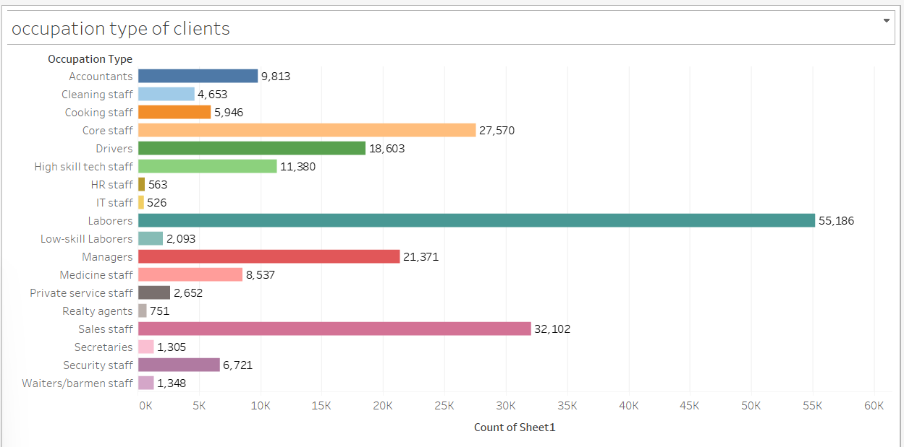
OCCUPATION TYPE OF CLIENTS
The occupation type of clients is important for differentiating clients with payment difficulties from all other cases because it can provide valuable insights into their financial situation and ability to make payments.
Clients in a certain industry may be more susceptible to economic downturns or have irregular income streams, which could make it difficult for them to make consistent payments.

Slide 25
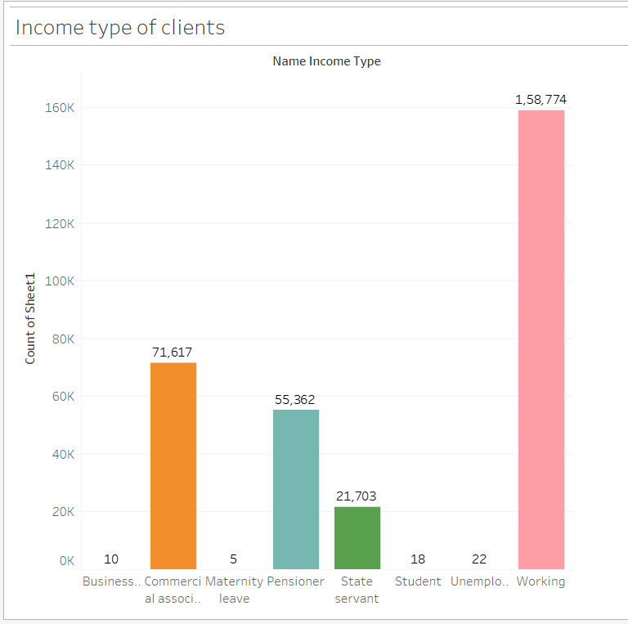
INCOME TYPE OF CLIENTS
The income type of clients is important for differentiating clients with payment difficulties from all other cases because it helps to identify the root cause of the payment difficulties.
By understanding the income type of clients, we can determine if the payment difficulties are due to a temporary financial setback or if they are a result of a more long-term financial issue.

Slide 26
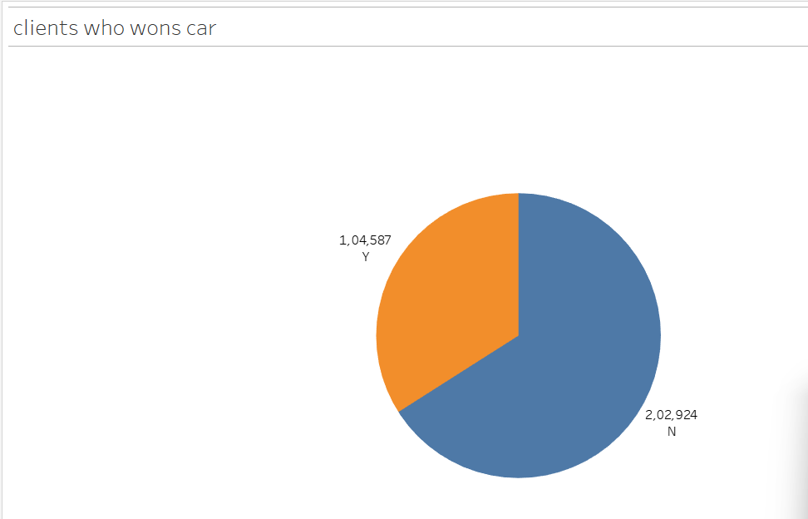
CLIENTS WHO OWN CAR
Owning a car can be a significant expense, including car payments, insurance, maintenance, and fuel costs. Clients who are able to afford a car may have a higher income or may prioritize transportation over other expenses.
However, if a client with a car is experiencing payment difficulties, it could indicate that they are struggling to manage their overall expenses and may be at risk of defaulting on their car loan or other debts.

Slide 27
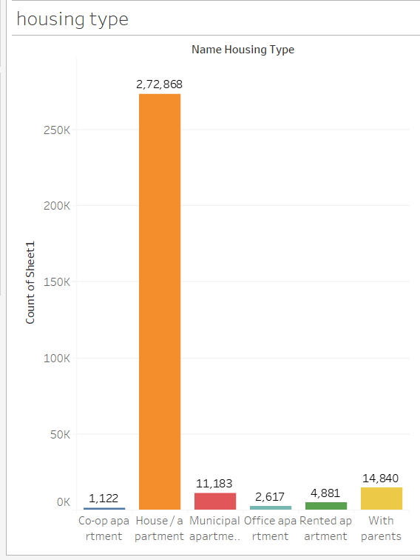
HOUSING TYPE
The housing type of clients is important because it can provide insights into their financial obligations and expenses.
Clients who own a home may have higher monthly mortgage payments and maintenance costs compared to those who rent.
This could impact their ability to make consistent payments or other financial obligations, such as credit bills or loans.

Slide 28

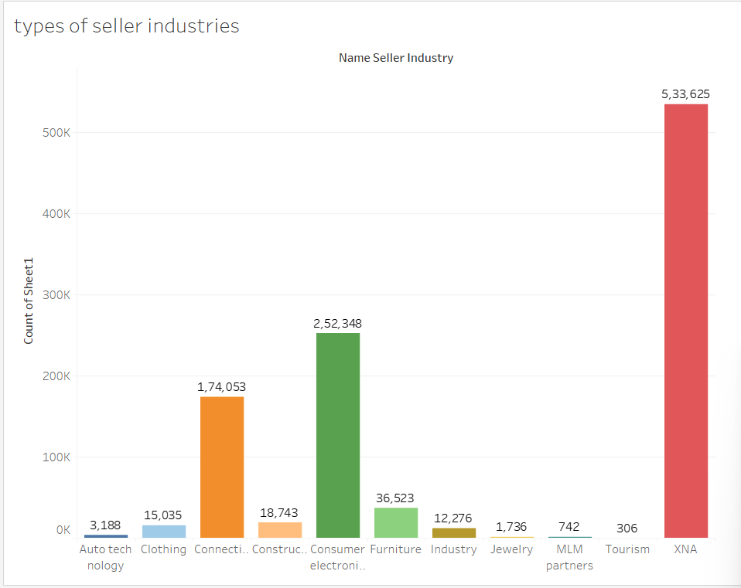
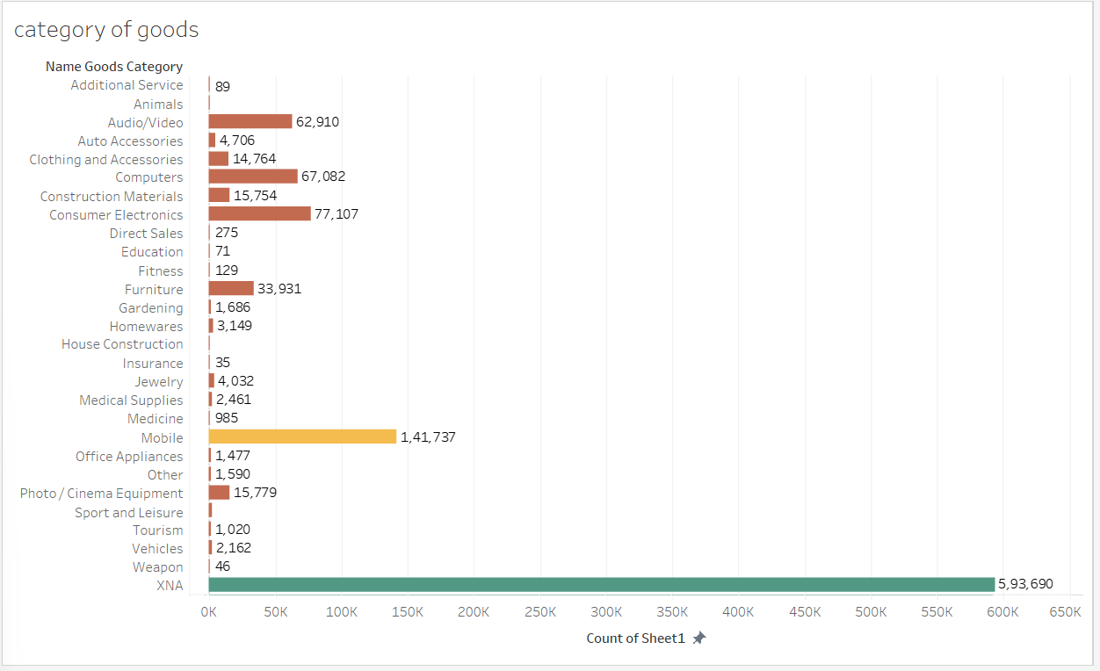
DASHBOARD

Slide 29

RESULT
In a bank loan case study, it is important to analyze the borrower's creditworthiness, financial history, and ability to repay the loan. The bank must also consider the purpose of the loan and the potential risks associated with lending to the borrower. By conducting a thorough analysis, the bank can make an informed decision about whether to approve or deny the loan application. Additionally, the bank must ensure that the loan terms are fair and reasonable for both the borrower and the bank. Proper risk management and due diligence are crucial in ensuring the success of the loan and minimizing the potential for default.

Slide 30

Thank You
Naveena Palem

